Slide 1
Matter
Solid, liquid and gas
Miss Doig

Slide 2
http://www.teachers.tv/video/12098
4.42 – 8.35

Slide 3
Have a fixed shape
Are hard
Are runny
Can be easily squashed
SOLID
LIQUID
GAS
Take the shape of container
Fill any space they are put in
Can be stirred
Can be poured

Slide 4
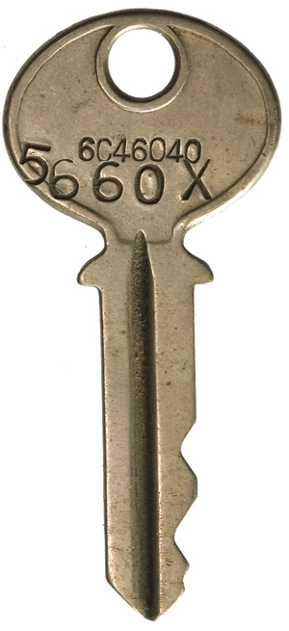
Solids, liquids, gases
Description of substance
Key
Water
Air

Slide 5
http://www.abpischools.org.uk/page/modules/solids-liquids-gases/slg2.cfm
2, 3, 6, 7

Slide 6
Solids
Can’t be squashed
Spreads to fill container
Flows
Keeps the same volume
Can change shape
Can be squashed smaller
Liquids
Keeps the same volume
Gases
Keeps its shape
Can’t be squashed

Slide 7
http://resources.schoolscience.co.uk/ICI/11-14/materials/match1pg1.html
Scroll down

Slide 8
http://lgfl.skoool.co.uk/content/keystage3/chemistry/pc/learningsteps/TPTLC/launch.html
Also test, Q1 + 2

Slide 9
Can you arrange yourselves as a…
Solid
Liquid
Gas

Slide 10
Solids
Widely spread out
Not in a regular pattern
Close together
Free to move
In a regular pattern
Not in regular pattern
Liquids
Gases
Close together
Can slide over each other

Slide 11
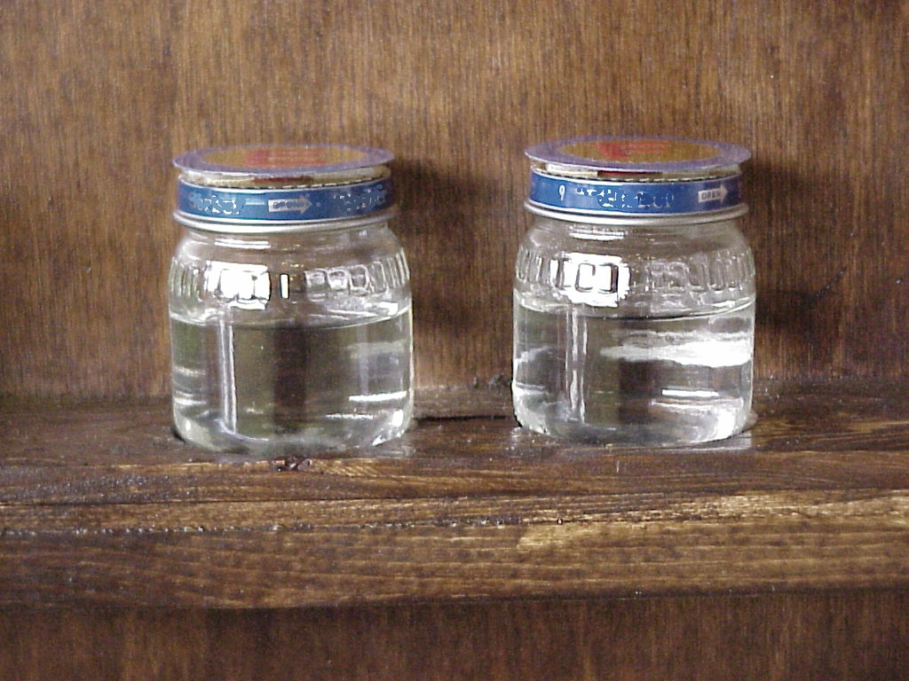
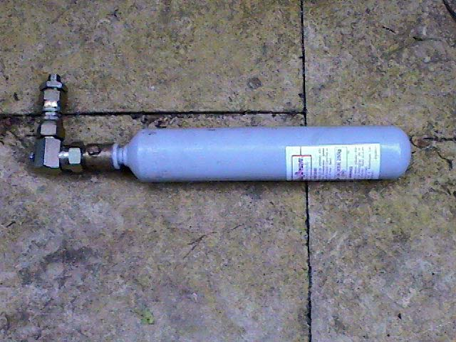
Matter
comes in 3 types
Solid
Gas
Liquid

Slide 12
Solid
Definite Shape
Definite Volume

Slide 13
Liquid
Indefinite Shape – takes the shape of the container
Definite Volume

Slide 14
Gas
Indefinite Shape – takes the shape of the container
Indefinite Volume – can expand and be compressed

Slide 15
This powerpoint was kindly donated to www.worldofteaching.com
http://www.worldofteaching.com is home to over a thousand powerpoints submitted by teachers. This is a completely free site and requires no registration. Please visit and I hope it will help in your teaching.

